Slide 1
CODE JUDGE
Client: Philip Ritchey
Anmol Anand
Druva Kumar Gunda
Loksubhash Pulivarthi
Nachiket Umesh Naganure
Nagarjuna Kolloju
Praveen Kumar Maddikuntla

Slide 2
Table of contents
Introduction to Code Judge
Requirements
Updated Database and Schema
Features & their implementations
Final product

Slide 3
Introduction
The Code Judge website is designed to help Texas A&M instructors to automate the creation and evaluation of programming assignments for their students.
To improve the overall user experience, we have been tasked with implementing incremental changes to the existing Code Judge platform.

Slide 4
Requirements
Language restriction for problems
Ability to add multiple problem tags
Dynamic problem difficulty based on student attempts
Problem filtering based on tags and difficulty
Problem attributes on the problems page
User scoreboard and dynamic student rating
Provide individual test case feedback on submission
Restricting problem edit privileges to author and admin
Admin privileges to edit/remove users
Fixing compilation flow
Adding more stats, attributes and improving UI for the entire platform
Notes:
These are the major requirments

Slide 5
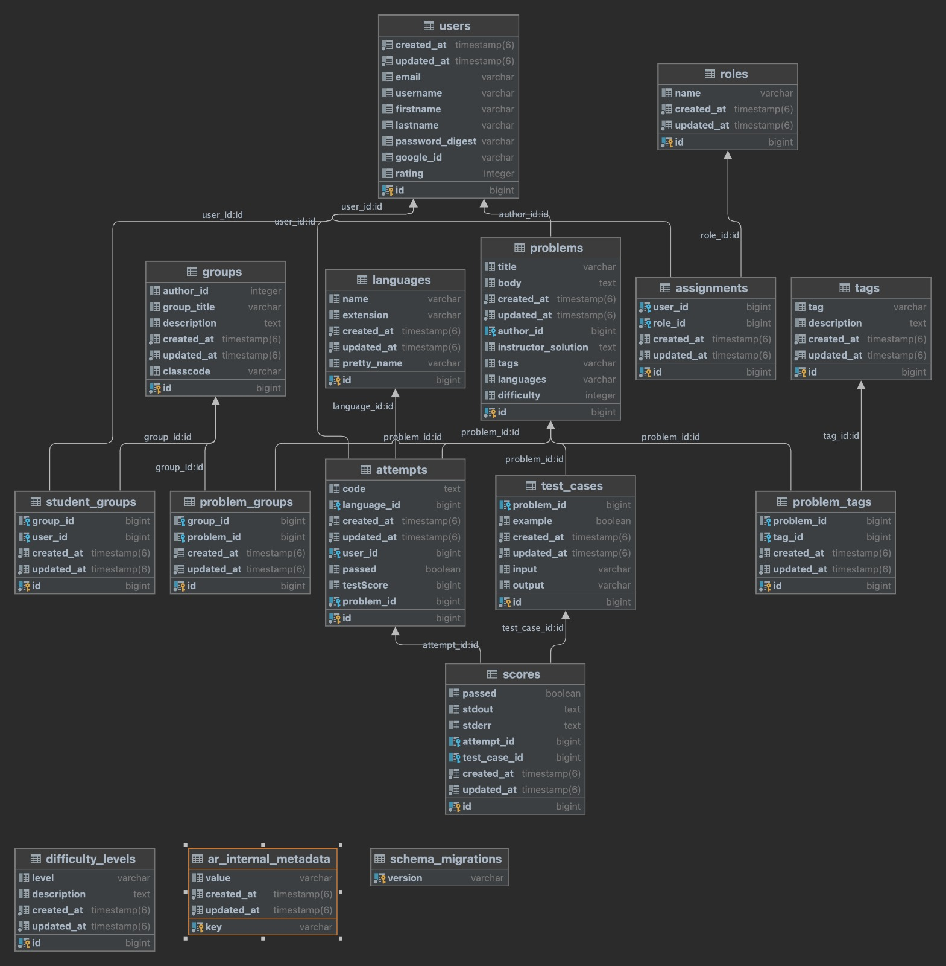
Updated database & schema
Notes:
The most important changes are attributes to facilitate the new client requirements such as language restriction, multiple tags, problem difficulty, and user rating system.

Slide 6
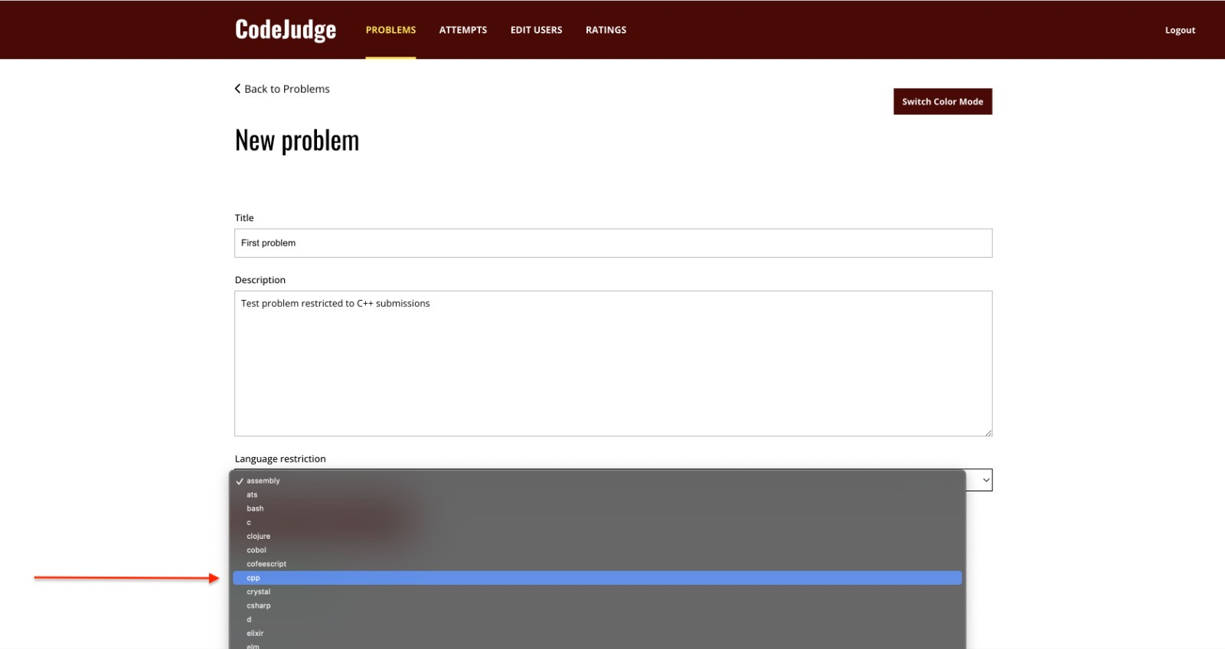
Language restriction for problems Instructor view: Add language restriction while creating a problem

Slide 7
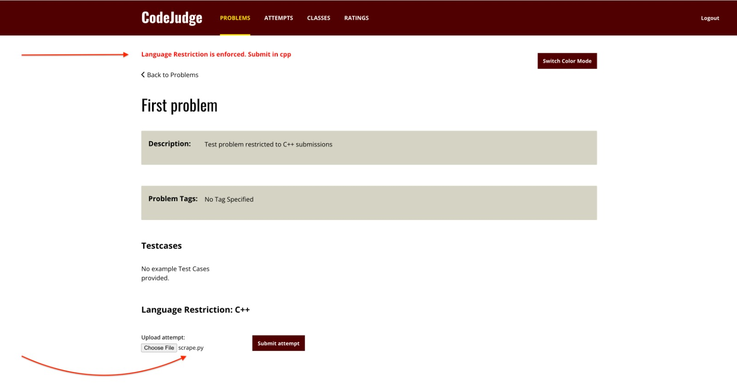
Language restriction for problems Student view: Error prompt if attempted in another language

Slide 8
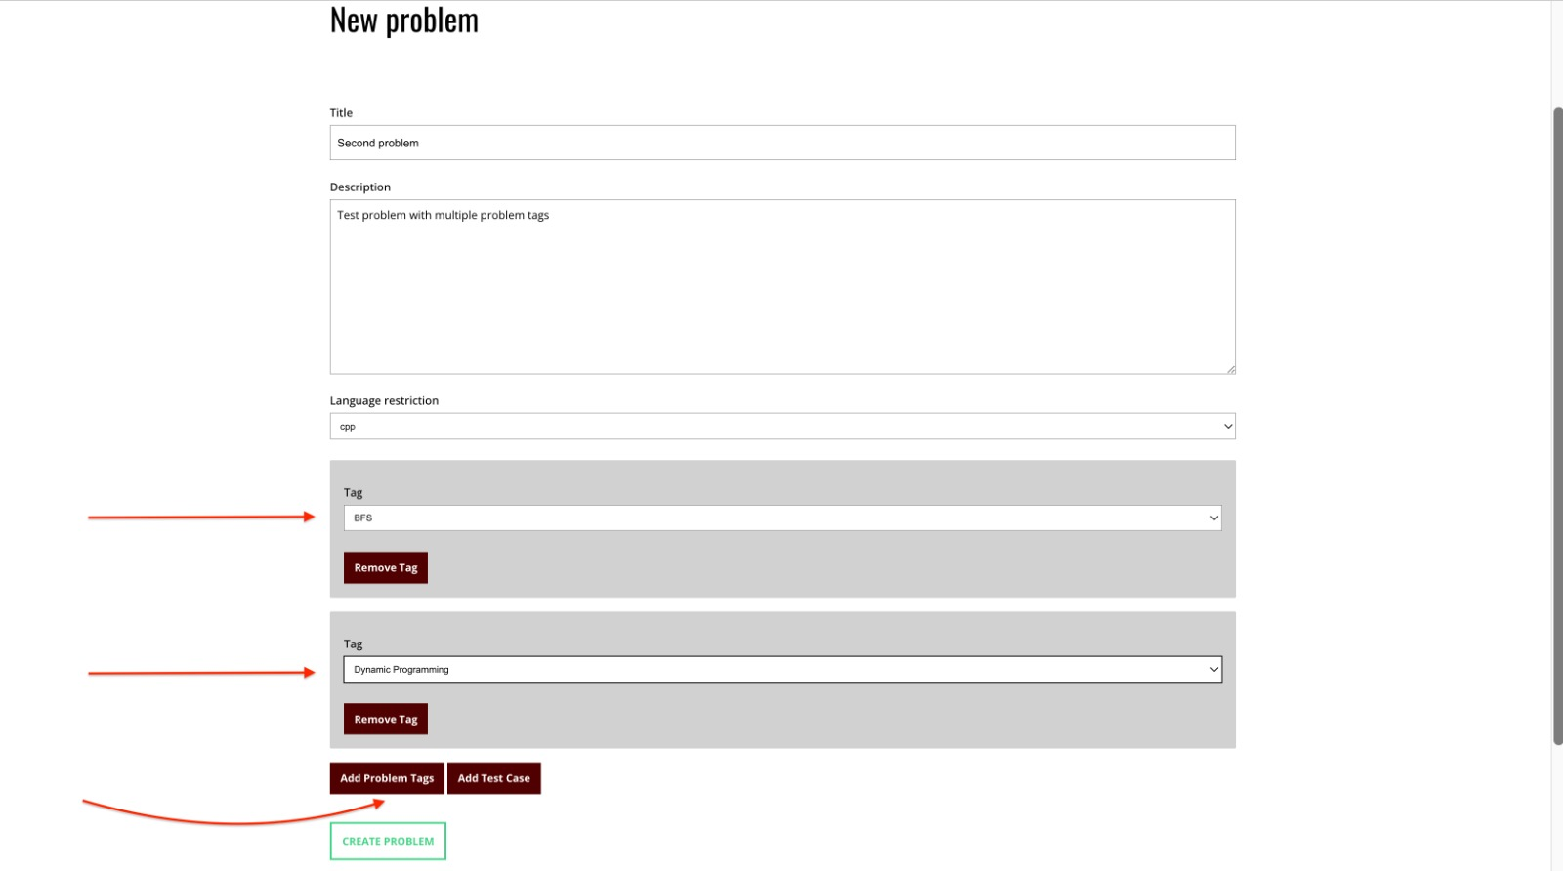
Ability to add multiple tags Instructor view: Add multiple tags during problem creation

Slide 9
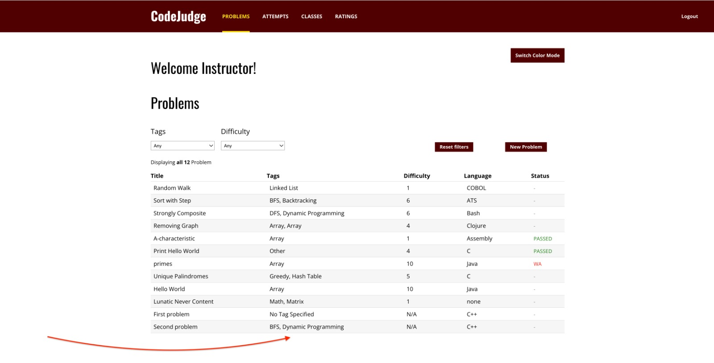
Ability to add multiple tags Problem tags in the problems view

Slide 10
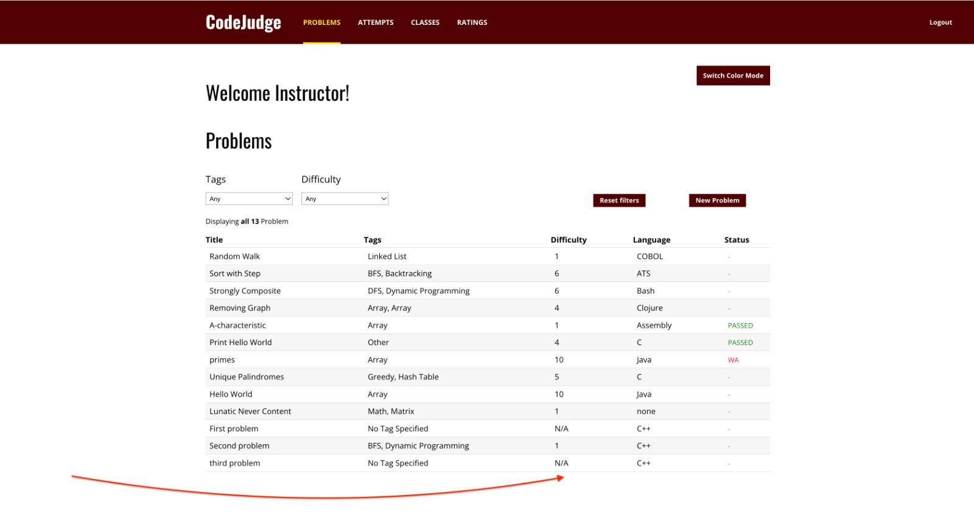
Dynamic problem difficulty based on student attempts The difficulty is not defined for a new (un-attempted) problem

Slide 11
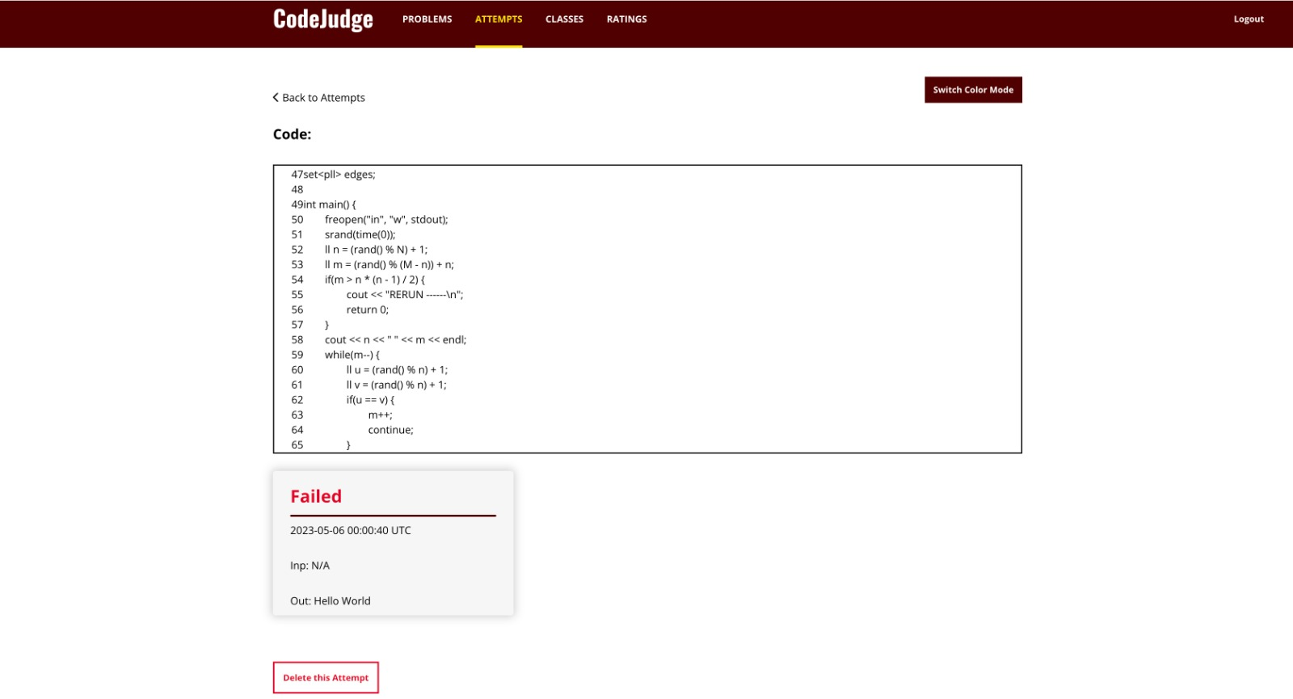
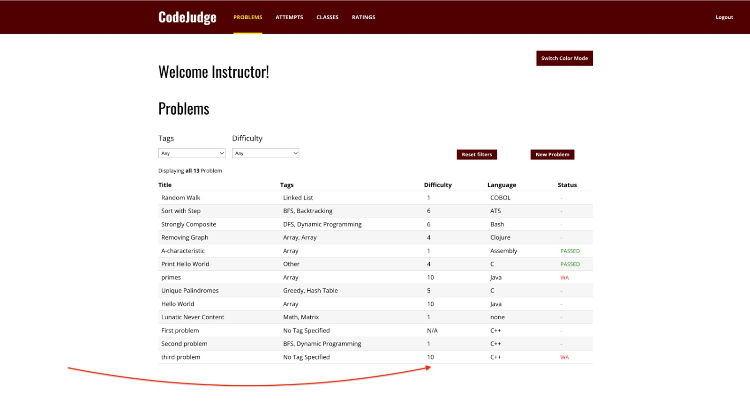
Dynamic problem difficulty based on student attempts Student view: Incorrect submissions increase problem difficulty

Slide 12
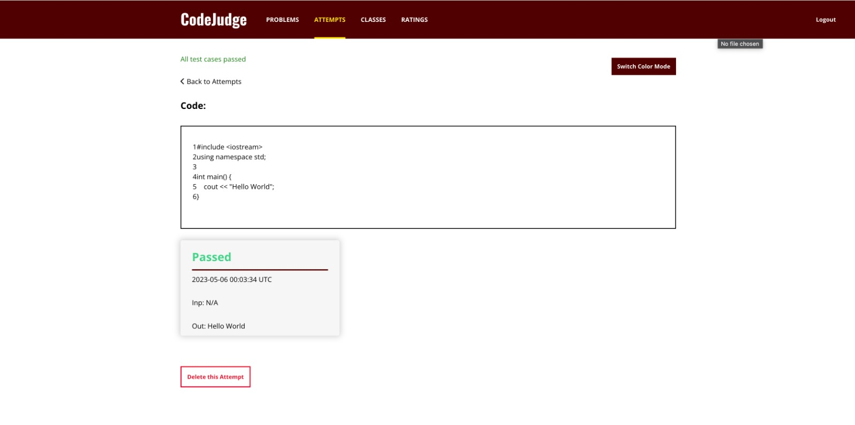
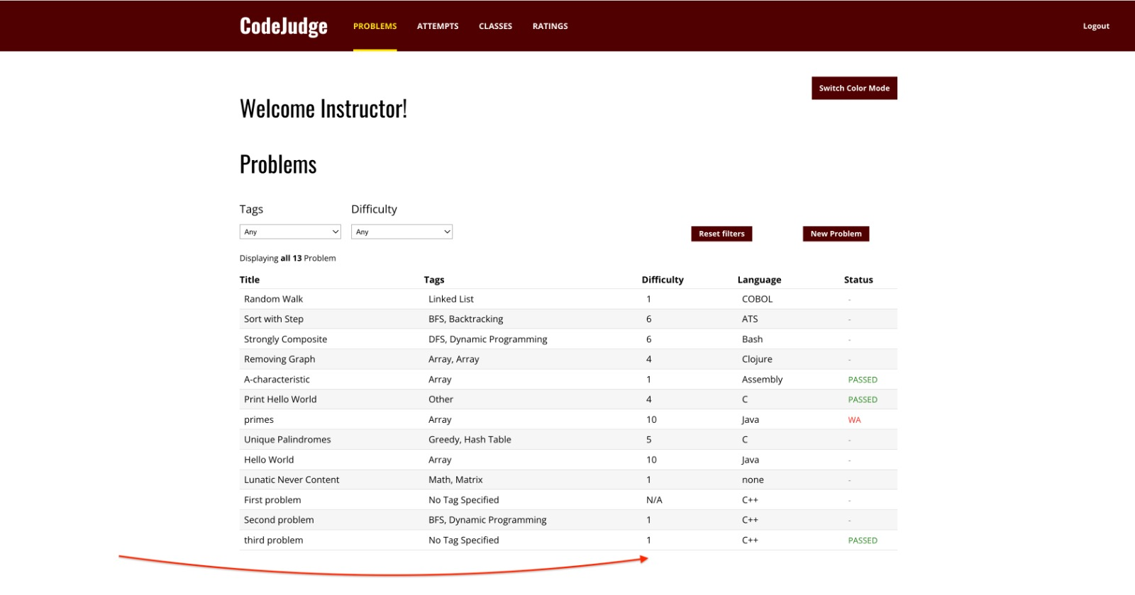
Dynamic problem difficulty based on student attempts Student view: Correct submissions decrease problem difficulty

Slide 13
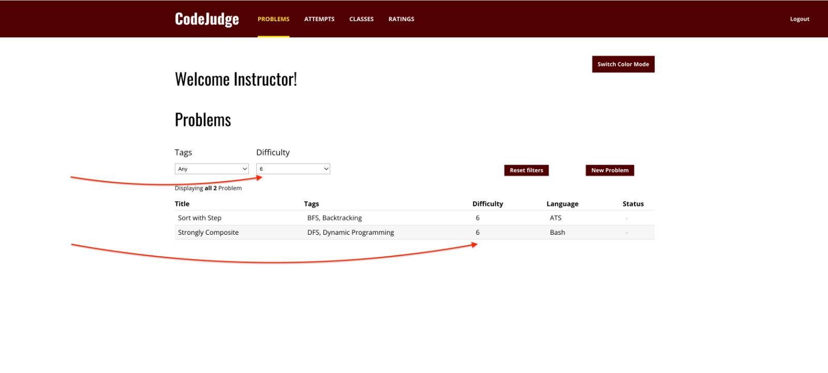
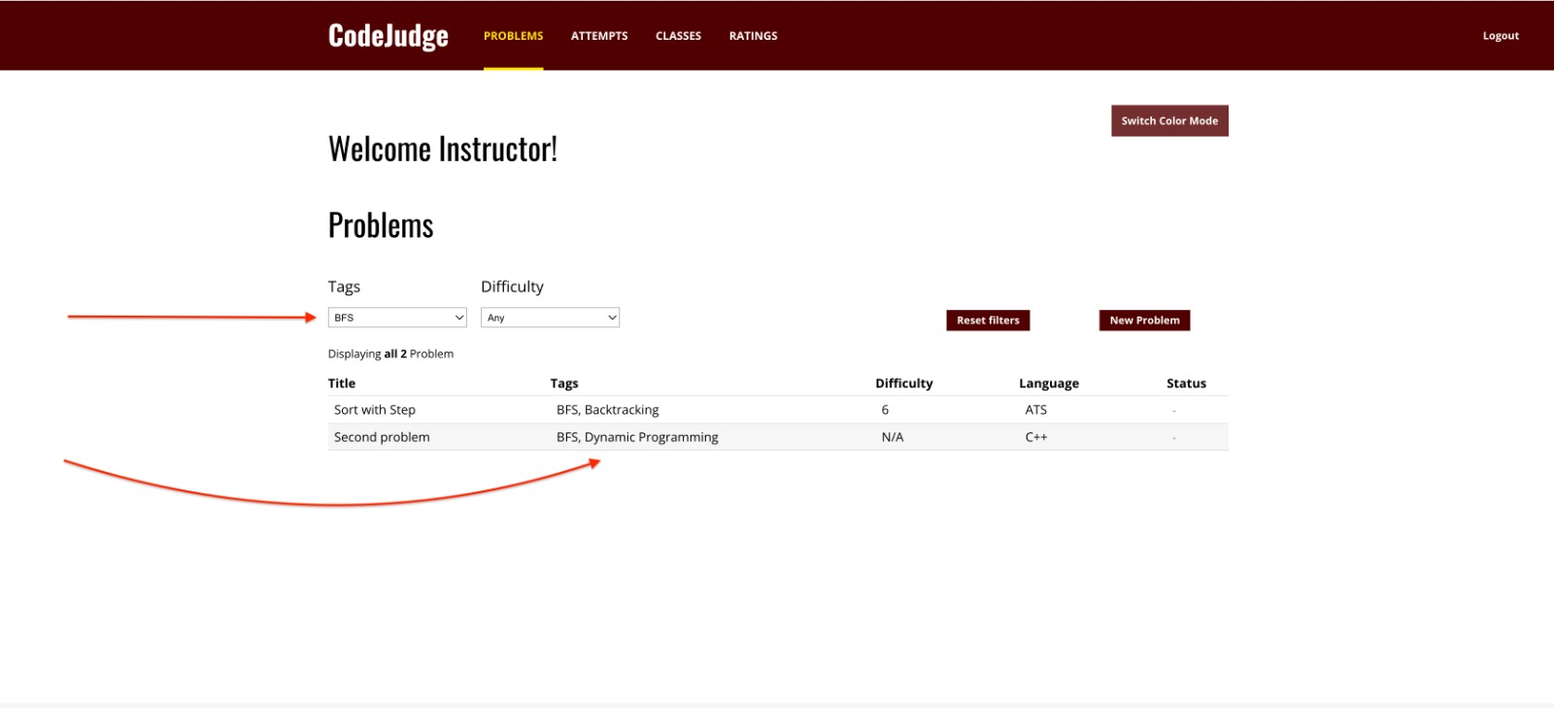
Problem filtering based on tags and difficulty

Slide 14
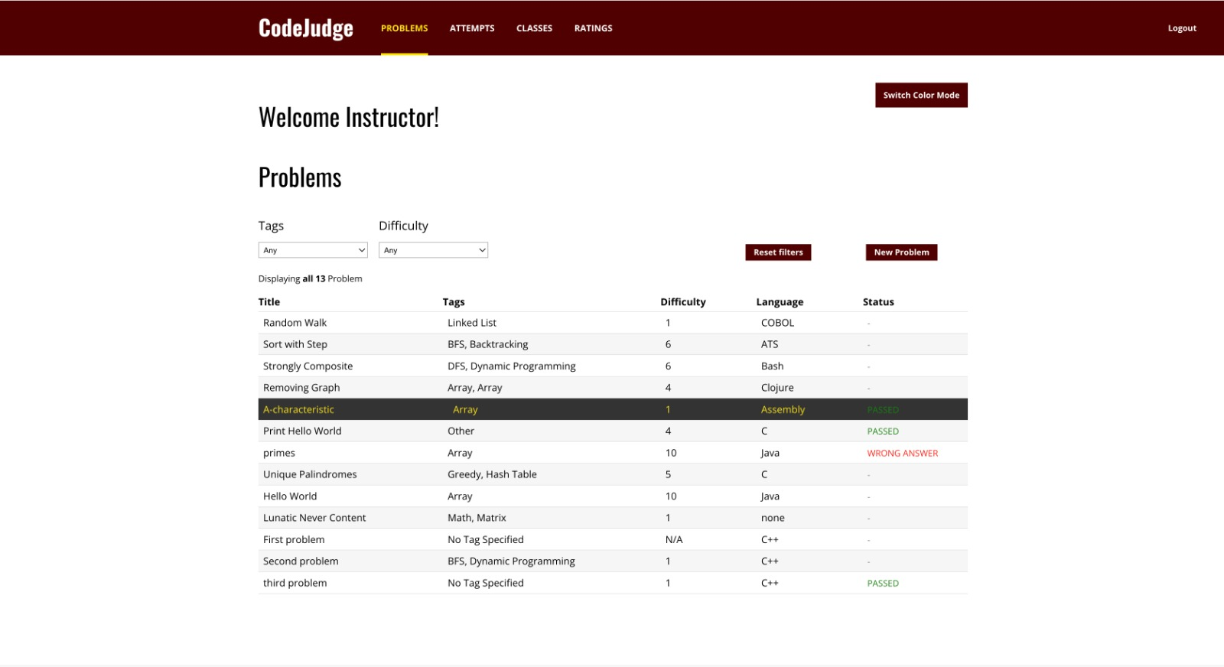
Problem attributes on the problems page Displaying problem attributes: {tags, difficulty, language restriction, status}

Slide 15
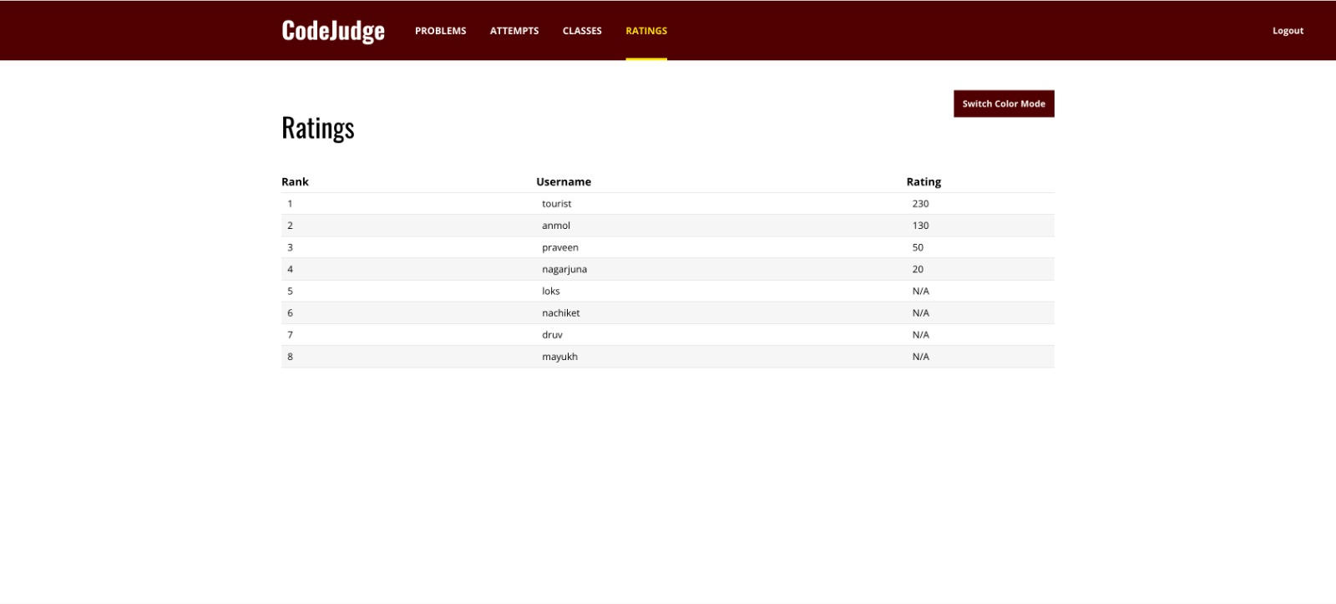
User scoreboard and dynamic student rating Student rating depends on the difficulty of solved problems

Slide 16
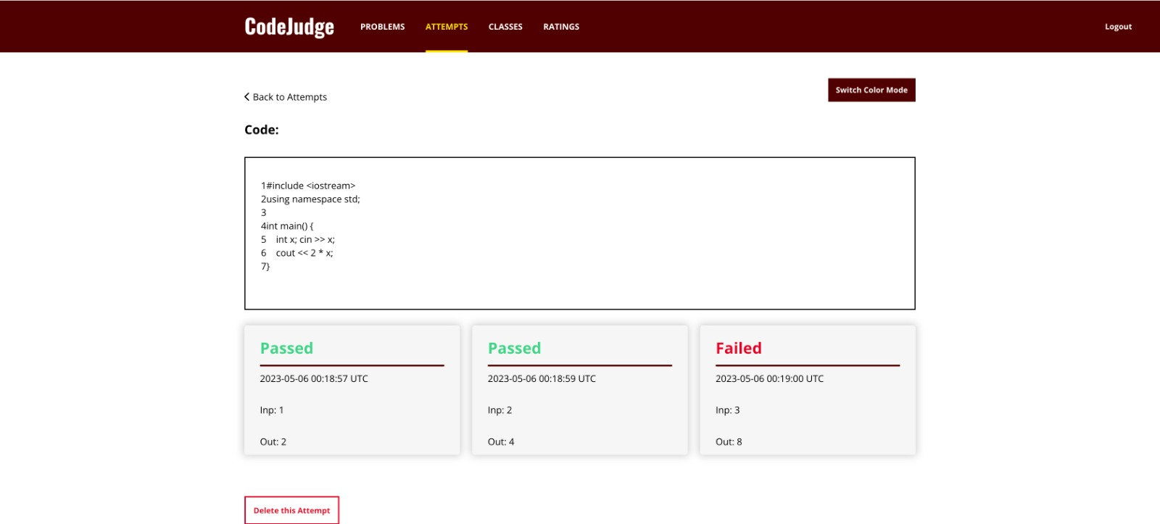
Provide individual test case feedback on submission

Slide 17
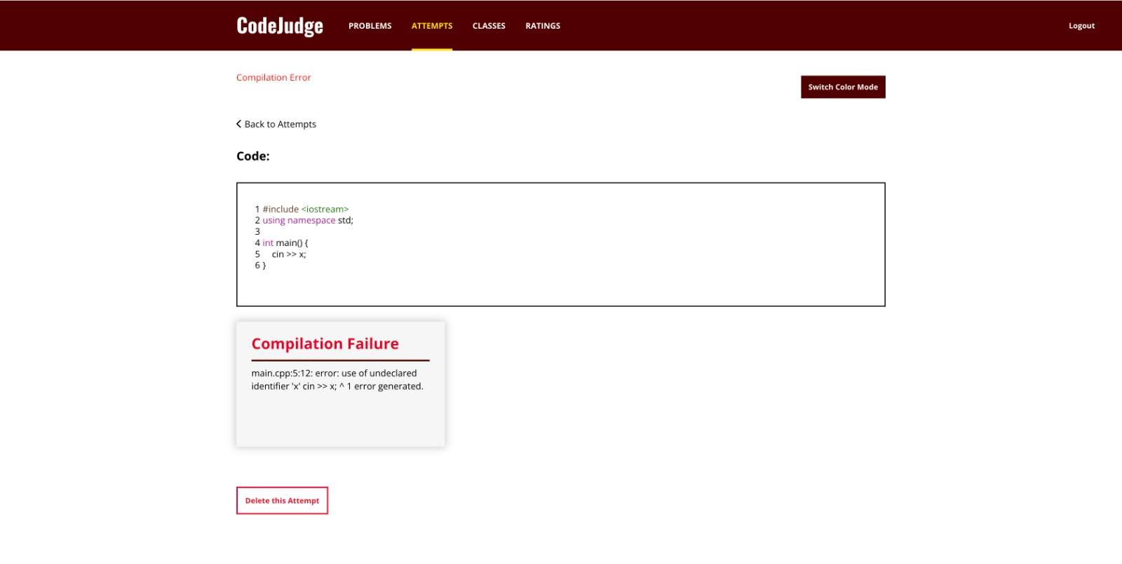
Provide individual test case feedback on submission Displaying stack trace in case of compilation failure

Slide 18
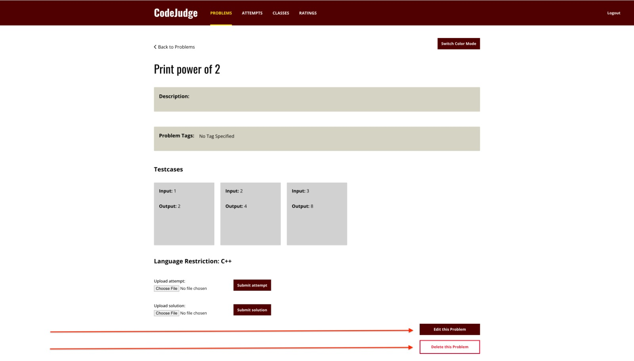
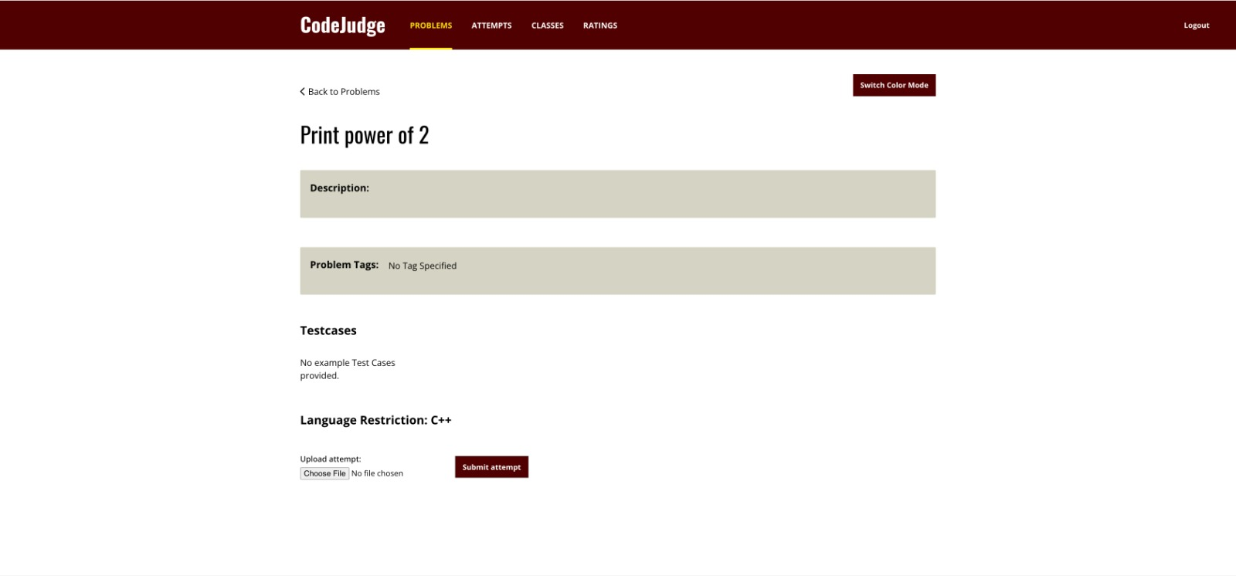
Restricting problem edit privileges to author and admin
Problem author and site admin can edit/delete the problem
Other can only attempt the problem

Slide 19
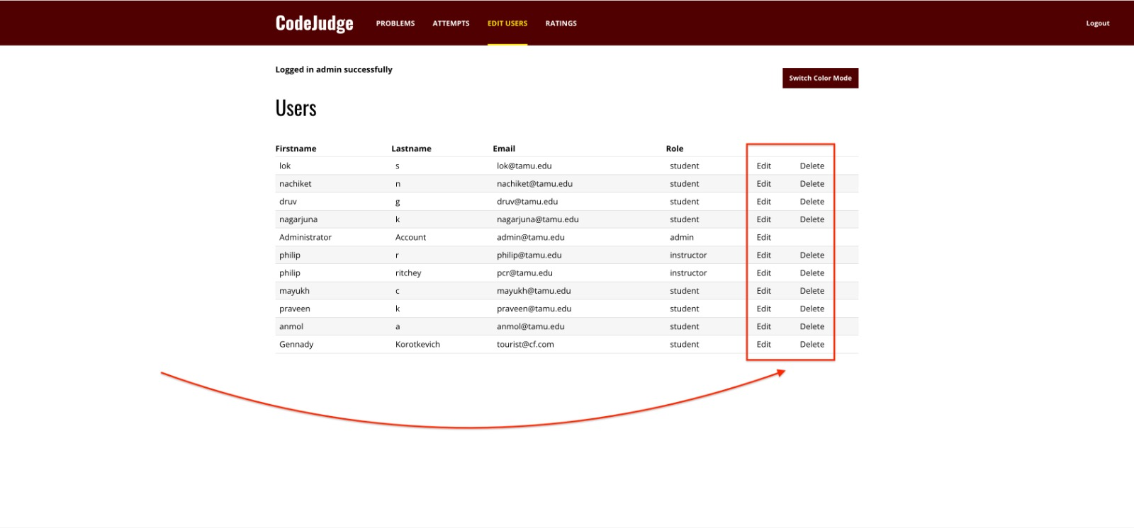
Admin privileges to edit/remove users

Slide 20
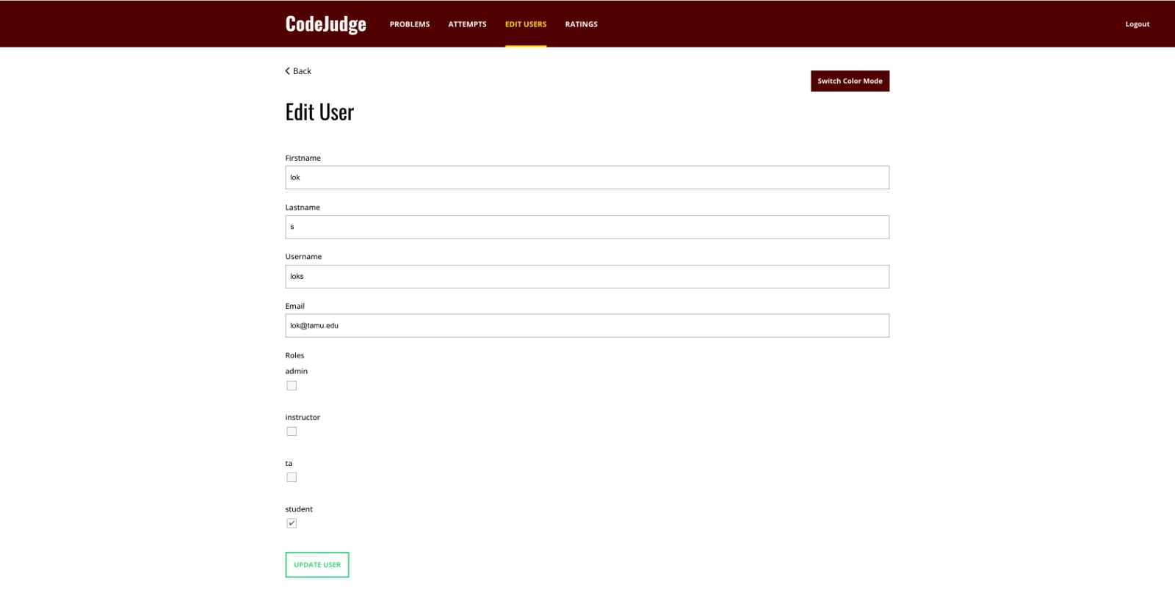
Admin privileges to edit/remove users

Slide 21
Challenges & Learnings
Challenges:
Lack of proper documentation for legacy code
Incomplete and non-working rspec and cucumber tests for legacy code
Configuring third-party services (Redis, Glot API)
Learnings:
Ruby on rails
Deploying to cloud platforms (Heroku)
Behavior-driven development
Agile methodology
Architecture of coding platforms

Slide 22
Feel free to visit our website!
https://codejudge-prod-app.herokuapp.com/

